Slide 1
Software Development 3
Collections and Generics

Slide 2
Java Collections Framework
Originally Java had Arrays, Vectors and Hashtables
All different methods (addElement(), put() )
No common interface

Slide 3
Collections Framework
The collections framework was designed to meet several goals.
  The framework is high-performance. The implementations for the fundamental collections (dynamic arrays, linked lists, trees, and hashtables) are highly efficient.
  The framework allows different types of collections to work in a similar manner and with a high degree of interoperability. Consistent API – some common set of methods
  Extending and/or adapting a collection is easy.

Slide 4
Collections Framework
Provides a unified architecture to store and manipulate a group of objects.
A Java collection framework includes the following:
  Interfaces
  Classes
  Algorithm

Slide 5
Interfaces
abstract data types that represent collections (more on this later)
Allow Java collections to be manipulated independently from the details of their representation.
Form a hierarchy in object-oriented programming languages.
E.g. List, Set

Slide 6
Classes
Concrete implementation of the collection interfaces.
Refers to the data structures that are used again and again.
E.g. ArrayList, LinkedList, HashSet, LinkedHashSet

Slide 7
Algorithms
Methods which are used to perform operations on objects that implement collection interfaces
E.g. searching and sorting
Algorithms are polymorphic in nature
  the same method can be used on many different implementations of the appropriate collection interface
  algorithms are reusable functionality

Slide 8
Hierarchy (Interfaces Only)
Collection
Map
List
Set
SortedMap
SortedSet
*Not full set of interfaces

Slide 9
Hierarchy (With Classes)
Collection
Map
List
Set
SortedMap
HashSet
HashMap
ArrayList
SortedSet
TreeMap
LinkedList
TreeSet
*Not full set of interfaces or classes

Slide 10
Interfaces:
Collection
  the root of the collection hierarchy
  represents group of objects known as Elements
Set
  a collection that cannot contain duplicate elements
SortedSet
  Set that maintains its elements in ascending order
List
  an ordered collection that can contain duplicate elements

Slide 11
Interfaces Cont.
Map
  an object that maps keys to values.
  Cannot contain duplicate keys: one key can map to at most one value
SortedMap
  Map that maintains mapping in ascending key order

Slide 12
Collections, Interfaces and Classes
The Java collection framework is interface based: each class in the collection implements one of the interfaces defined by the collection framework.
Collections store individual objects as elements.
Maps store pairs of key objects and value objects in a way that lets you retrieve a value object based on its key.
Although there are many classes in the Java collection framework, the most commonly used classes are the ArrayList, LinkedList, HashSet, HashMap, and TreeMap classes.

Slide 13
Iterators
Often, you will want to cycle through the elements in a collection. For example, you might want to display each element.
The easiest way to do this is to employ an iterator, which is an object that implements either the Iterator or the ListIterator interface.
Iterator enables you to cycle through a collection, obtaining or removing elements. ListIterator extends Iterator to allow bidirectional traversal of a list and the modification of elements.

Slide 14
Iterators
Before you can access a collection through an iterator, you must obtain one.
Each of the collection classes provides an iterator( ) method that returns an iterator to the start of the collection.
By using this iterator object, you can access each element in the collection, one element at a time.

Slide 15
Iterators
In general, to use an iterator to cycle through the contents of a collection, follow these steps:
Obtain an iterator to the start of the collection by calling the collection's iterator( ) method.
Set up a loop that makes a call to hasNext( ). Have the loop iterate as long as hasNext( ) returns true.
Within the loop, obtain each element by calling next( ).

Slide 16
The Methods Declared by Iterator
boolean hasNext()
  Returns true if there is another element, otherwise returns false
Object next() //note capital O – it’s an actual object!
  Returns the next element, if there isn’t one, throws “NoSuchElementException”
void remove()
  Removes the current element. If called without next() being called before it, throws “IllegalStateException”

Slide 17
The Methods Declared by ListIterator
Including the methods in the previous slide…
void add(Object o)
  Inserts o into the list in front of the element that will be returned by the next call to next()
boolean hasPrevious()
  Returns true if there is a previous element, otherwise returns false
int nextIndex()
  Returns the index of the next element. If there is not a next element, returns the size of the list

Slide 18
The Methods Declared by ListIterator Cont.
Object previous()
  Returns the previous element. A “NoSuchElementException” is thrown if there is not a previous element
int previousIndex()
  Returns the index of the previous element. If there is not a previous element, returns -1
void set(Object o)
  Assigns o to the current element. This is the element last returned by a call to either next() or previous()
Note the return types for all of these methods…..

Slide 19
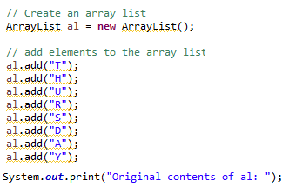
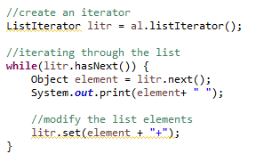
Iterator Example
import java.util

Slide 20
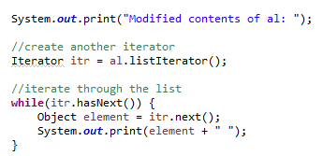
Iterator Example

Slide 21
Lists
The List interface extends Collection and declares the behavior of a collection that stores a sequence of elements
Elements can be inserted or accessed by their position in the list, using a zero-based index
A list may contain duplicate elements
In addition to the methods defined by Collection, List defines some of its own, which are summarized in the following slides

Slide 22
The List Interface Methods
void add(int index, Object o)
  Inserts o into the list at the index passed in. Any pre-existing element at or after this point are moved up one. No elements are overwritten.
boolean addAll(int index, Collection c)
  Inserts all elements of c into the list at the index passed in. No elements overwritten (as above). Returns true if list changes (added), false otherwise.
Object get(int index)
  Returns object stored at specified index
int indexOf(Object o)
  Returns the index of the first instance of o in the list. If o is not in the list, returns -1

Slide 23
The List Interface Methods
int lastIndexOf(Object o)
  Returns the index of the last instance of o in the list. If o is not in the list, returns -1
ListIterator listIterator()
  Returns an iterator to the start of the list
ListIterator listIterator(int index)
  Returns an iterator to the index given of the list
Object remove(int index)
  Removes the object from the list at the index given

Slide 24
The List Interface Methods
Object set(int index, Object o)
  Assigns o to the location specified by index in the list
List subList(int start, int end)
  Returns a list that includes elements from start to end -1
  Includes start, does not include end!

Slide 25
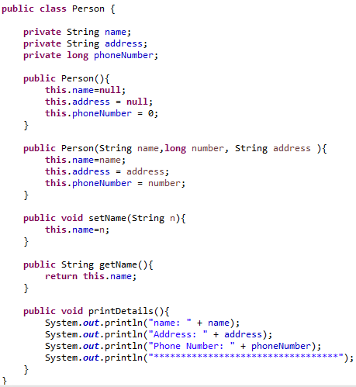
ArrayList Example

Slide 26
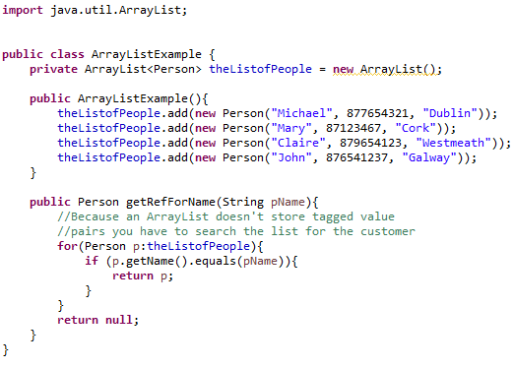
ArrayList Example

Slide 27
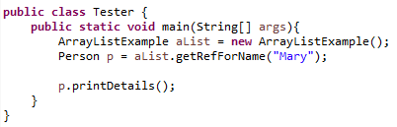

ArrayList Example
Creating a new ArrayList in the same manner we created people, cars etc.
Using the methods belonging to the class
  aList.getRefForName(“Name”)
ArrayList class had created people to insert into list so we can use Person p and therefore p.printDetails()

Slide 28
Maps
The Map interface maps unique keys to values. A key is an object that you use to retrieve a value at a later date.
Given a key and a value, you can store the value in a Map object. After the value is stored, you can retrieve it by using its key.
Several methods throw a NoSuchElementException when no items exist in the invoking map.
A ClassCastException is thrown when an object is incompatible with the elements in a map.

Slide 29
`Map Interface Methods
void clear()
  Removes all key/value pairs from the map
boolean containsKey(Object k)
  Returns true if the map contains k as a key. Otherwise returns false
boolean containsValue(Object v)
  Returns true if the map contains v as a value. Otherwise returns false
Set entrySet()
  Returns a Set that contains the entries in the map. The set contains objects of type Map.Entry – This method provides a set-view of the map

Slide 30
Map Interface Methods
boolean equals(Object o)
  Returns true if o is a Map and contains the same entries. Otherwise returns false. (note on equals() method)
Object get(Object k)
  Returns the value associated with the key k
int hashCode()
  Returns the hash code for the map
boolean isEmpty()
  Returns true if the map is empty, otherwise returns false

Slide 31
Map Interface Methods
Set keySet()
  Returns a Set that contains the keys in the map. Provides a set-view of the keys in the map
Object put(Object k, Object v)
  Puts an entry in the map, overwriting any previous value associated with the key. Key and Value are k and v respectively. Returns null if the key did not exist, otherwise returns the previous value linked to the key.
void putAll(Map m)
  Puts all entries from m into this Map

Slide 32
Map Interface Methods
Object remove(Object k)
  Removes the entry whose key equals k
int size()
  Returns the number of key/value pairs in the map
Collection values()
  Returns a collection containing the values in the map. This provides a collection-view of the values in the map

Slide 33
Map Example

Slide 34
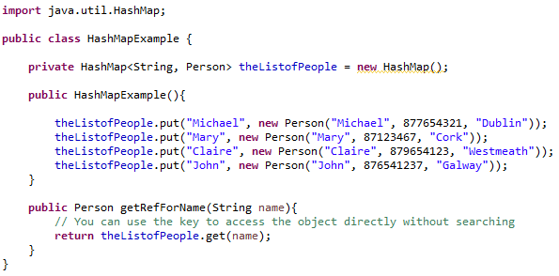
Map Example

Slide 35
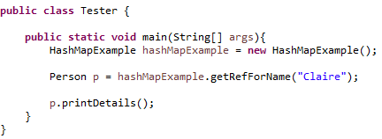

Map Example
Creating a new HashMap in the same manner we created people, cars etc.
Note HashMaps use
  Key: Claire
  Value: Person object with name Claire

Slide 36
Generics
It would be nice if we could write a single sort method that could sort the elements in an Integer array, a String array or an array of any type that supports ordering.
Java Generic methods and generic classes enable programmers to specify, with a single method declaration, a set of related methods or, with a single class declaration, a set of related types, respectively.
Using Java Generic concept, we might write a generic method for sorting an array of objects, then invoke the generic method with Integer arrays, Double arrays, String arrays and so on, to sort the array elements.

Slide 37
Generic Methods
You can write a single generic method declaration that can be called with arguments of different types.
Based on the types of the arguments passed to the generic method, the compiler handles each method call appropriately.

Slide 38
Type Parameter Naming Conventions
The most commonly used type parameter names are:
E - Element (used extensively by the Java Collections Framework)
K - Key
N - Number
T - Type
V - Value

Slide 39
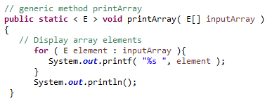
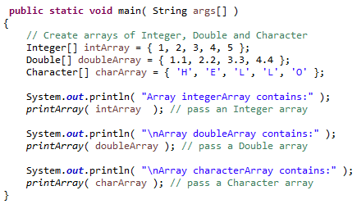
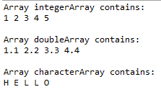
Generic Method Example

Slide 40
Challenges
Create a Student Class
  Name
  Student id (unique)
  Course
Create ArrayList or Map (your choice)
  getStudentByID
  *not on Moodle, (Map have ID as key, or ArrayList create method to getRefbyID using same idea as seen in ArrayList Example)
Create GenericMethod test to return different Arrays and ArrayLists (overloading)
  *on Moodle

Slide 41
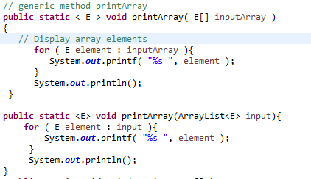
Overloading printArray()

Slide 42
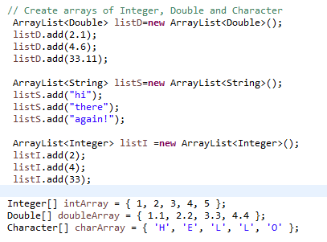
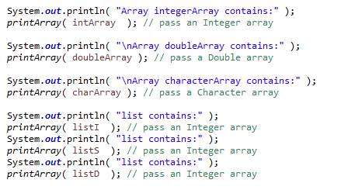
Creating and printing Arrays and ArrayLists

Slide 43
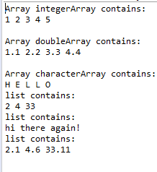
Output

